Slide 1


Semantic Object and Instance Segmentation
Anurag Arnab
Collaborators: sadeep Jayasumana, shuai zheng, Philip torr

Slide 2
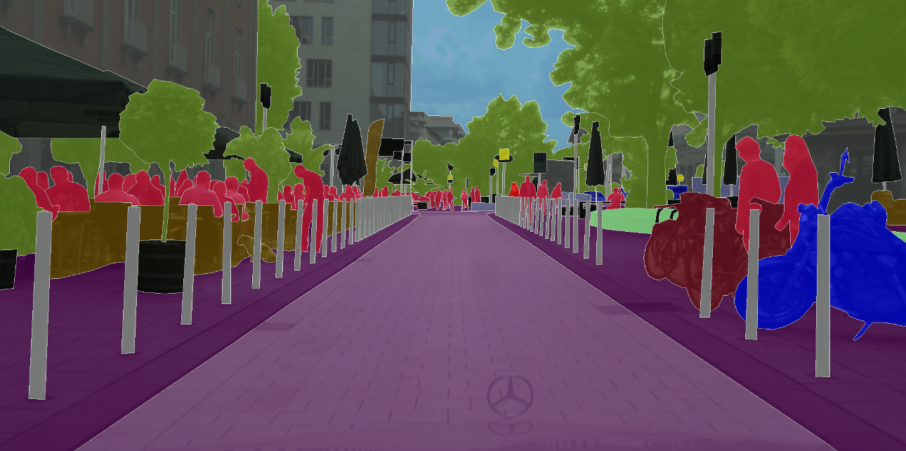
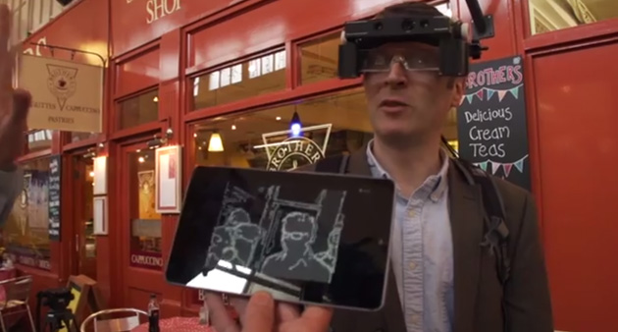
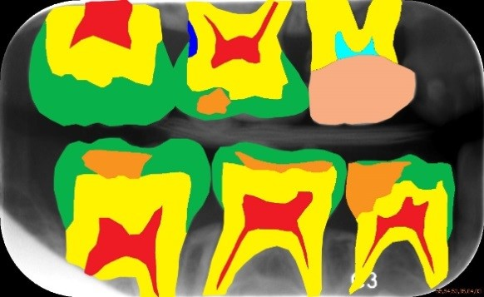
Introduction
Semantic Segmentation
Labelling every pixel in an image
A key part of Scene Understanding
Applications
Autonomous navigation
Assisting the partially sighted
Medical diagnosis
Image editing
(Clockwise from top) [1] Cityscapes Dataset. [2] ISBI Challenge 2015, dental x-ray images. [3] Royal National Institute of Blind People
Notes:
Semantic Segmentation is the task of labelling each pixel in an image with its object class
And it has many applications, such as autonomous driving – since cars need to understand the environment around them, image editing (for example, put the people in the image into focus), and assisting the partially sighted (which is a project underway in our lab)

Slide 3
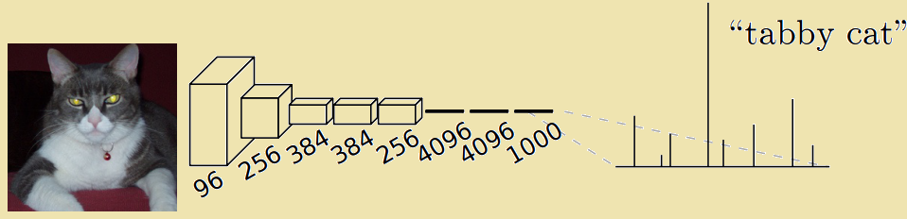
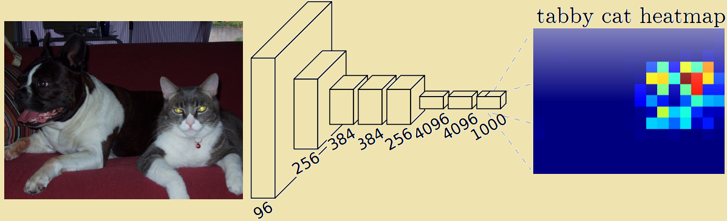
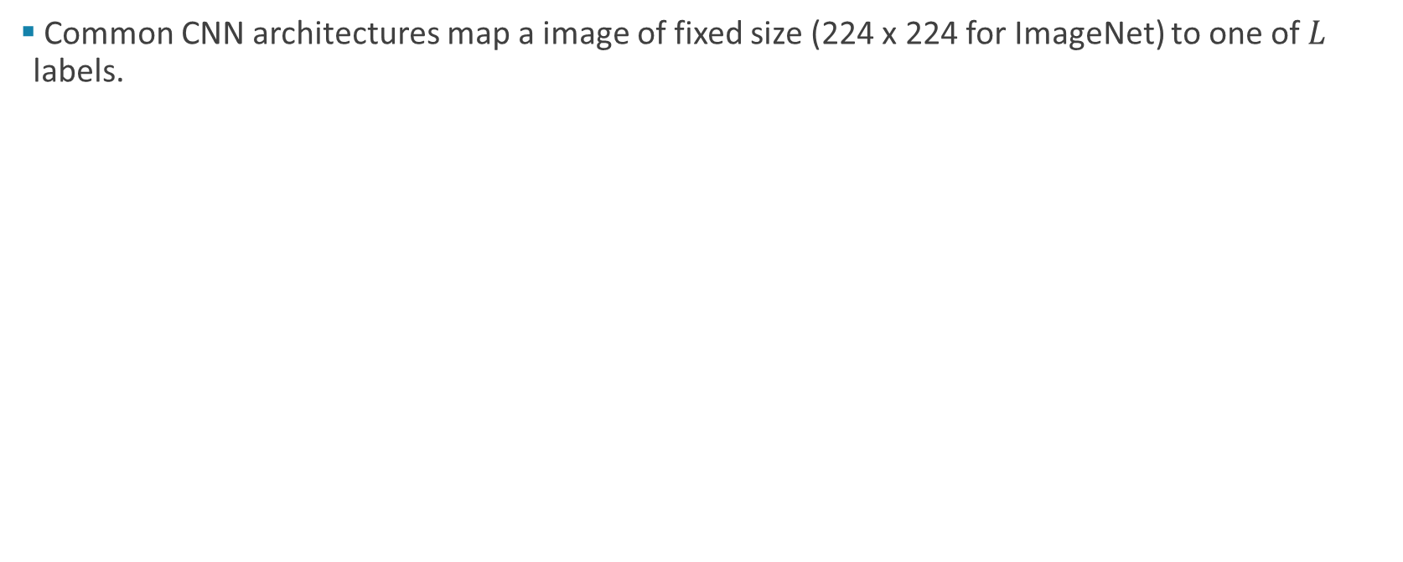
Fully Convolutional Networks (FCN)
Common CNN architectures map a image of fixed size (224 x 224 for ImageNet) to one of $L$ labels.
[1] Long et al, CVPR, 2015
Notes:
A key idea for performing Semantic Segmentation with CNNs are Fully Convolutional Networks.
Standard CNNs trained on ImageNet map a 224x224 image to a distribution of scores for each label in the dataset. However, fully-connected layers found at the end of a CNN are equivalent to a convolution where the size of the filter is the size of the input feature map.
By converting fully connected layers into convolutional ones, we can process input images of any size. However, due to max-pooling in the network, our output is a low resolution version. In the original FCN paper, they perform bilinear upsampling at the end.

Slide 4
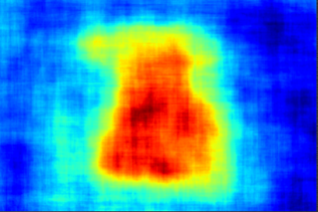
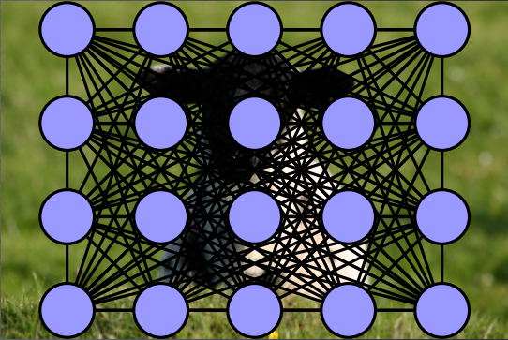
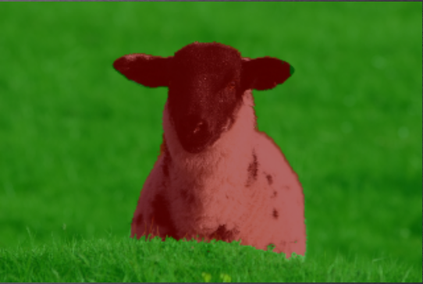
Structure
However, FCNs classify each pixel of an image independently
Probabilistic graphical models, such as Conditional Random Fields (CRFs) have been used extensively in prior literature to predict structures and incorporate prior knowledge.
Coarse output from the pixel-wise classifier
CRF modelling
Output after the CRF inference
Notes:
Although FCNs exploit the power of deep networks and CNNs, they still classify each pixel of an image independently.
However, we actually want to do structured prediction here, since the pixels are interrelated with each other. For example, if I know that one pixel is sheep, then it is likely that the pixel next to it is probably a sheep too.
Conditional Random Fields have been used to incorporate this prior knowledge in the past before, long before deep learning. It is possible to take the output of FCN and apply a CRF as post-processing, but we would prefer to do everything end-to-end instead.

Slide 5
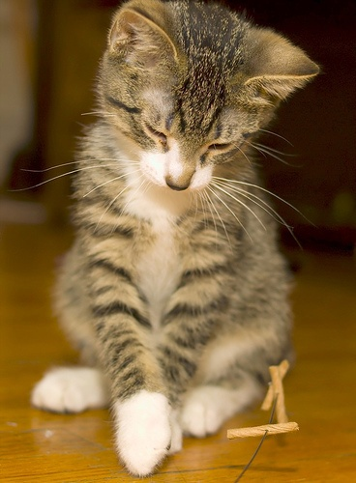

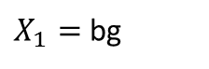
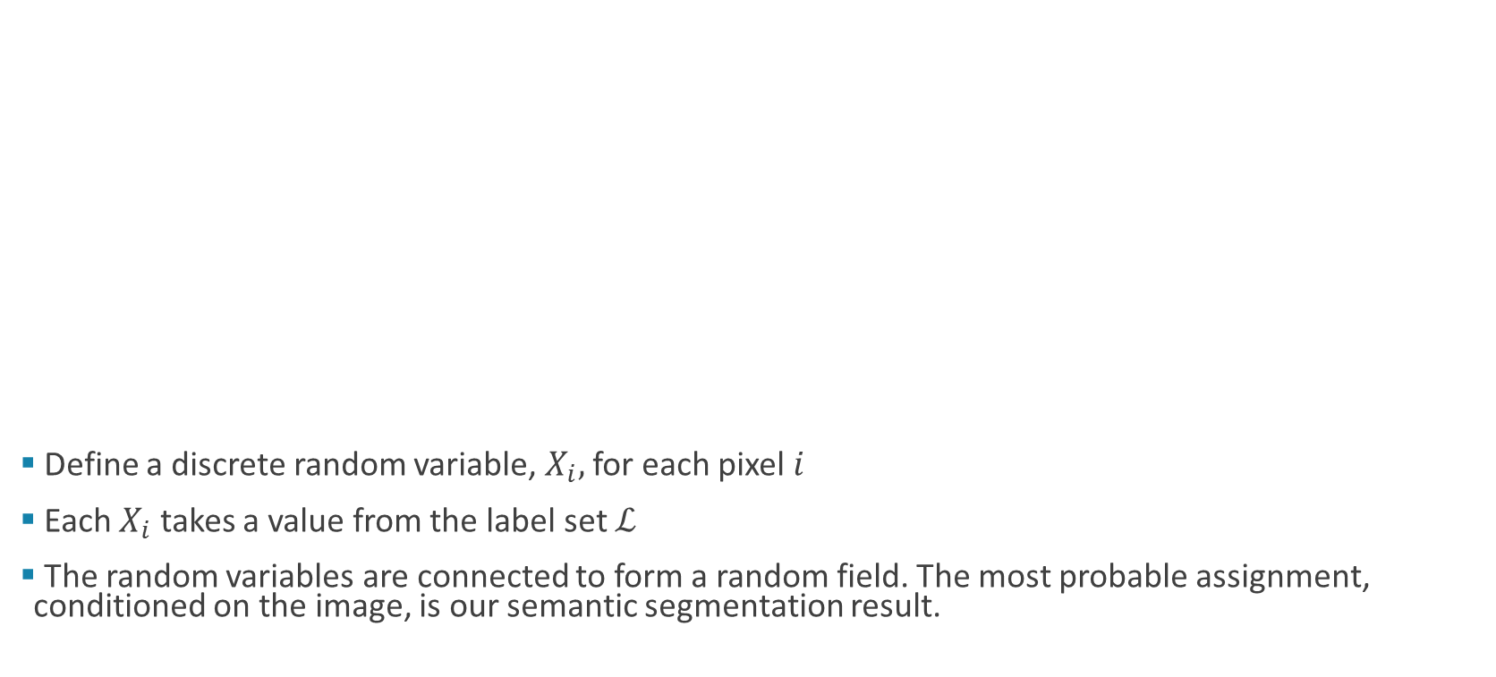
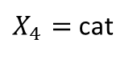
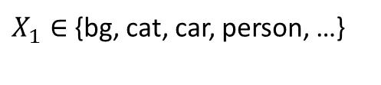
Conditional Random Fields
$X_{1}∈$ {bg, cat, car, person, …}
$X_{1}=$ bg
$X_{4}=$ cat
Define a discrete random variable, $X_{i},$for each pixel $i$
Each $X_{i}$ takes a value from the label set $ℒ$
The random variables are connected to form a random field. The most probable assignment, conditioned on the image, is our semantic segmentation result.
Notes:
So just a bit of intro to CRFs.
We define a discrete random variable for every pixel in the image
This random variable can take on a value from our label set
Random variables are connected to each other to form a field.
We are interested in the most probable assignment

Slide 6
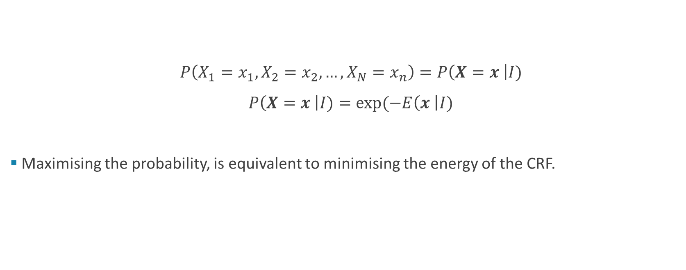
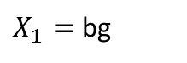
The Best Assignment
$P\left(X_{1}=x_{1}, X_{2}=x_{2}, …, X_{N}=x_{n}\right)=P\left(X=x \right|I)$
$P\left(X=x \right|I)=\exp{(−E\left(x \right|I)}$
Maximising the probability, is equivalent to minimising the energy of the CRF.
$X_{1}=$ bg
Notes:
The probability of an assignment is related to the energy of the CRF, since the CRF defines a Gibbs distribution
Each configuration of random variables has an energy associated with it
And the most probable configuration is that with the lowest energy
The energies functions are defined by us
Part of it is data driven
Other parts encode our own priors

Slide 7
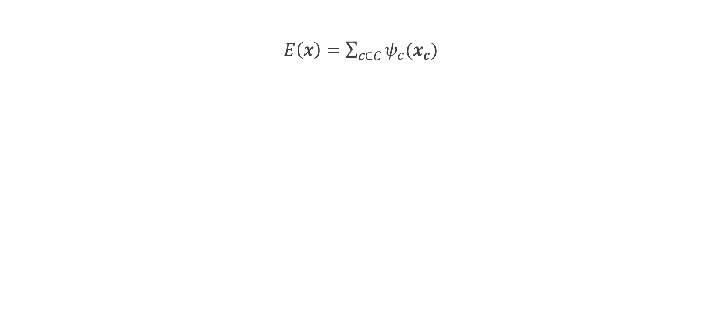
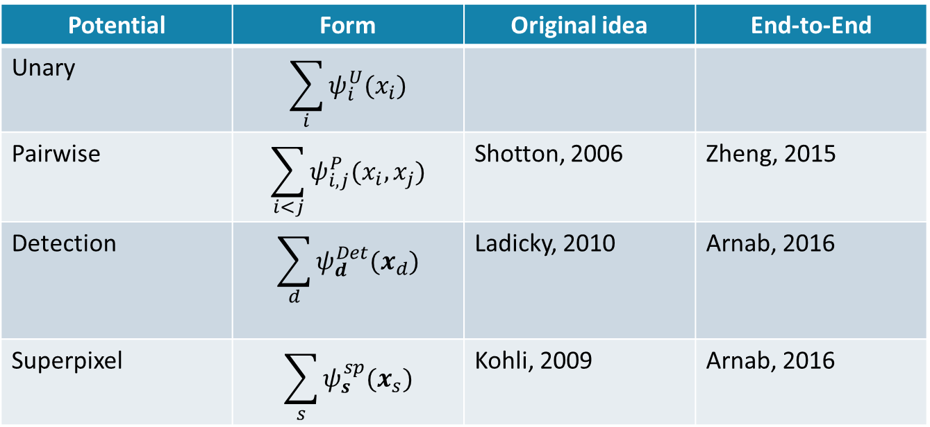
Energy Function
$E\left(x\right)=\sum_{c∈C}{ψ_{c}(x_{c})}$
Potential | Form | Original idea | End-to-End
Unary | $$\sum_{i}{ψ_{i}^{U}(x_{i})}$$
Pairwise | $$\sum_{i<j}{ψ_{i,j}^{P}(x_{i}, x_{j})}$$ | Shotton, 2006 | Zheng, 2015
Detection | $$\sum_{d}{ψ_{d}^{Det}(x_{d})}$$ | Ladicky, 2010 | Arnab, 2016
Superpixel | $$\sum_{s}{ψ_{s}^{sp}(x_{s}})$$ | Kohli, 2009 | Arnab, 2016
Notes:
Energies are defined over cliques of random variables
A clique is a set of random variables which are conditionally dependent on each other
There is a vast body of literature on graphical models, and how to do inference on them.
A key part of our work, is showing that this inference can be done end-to-end in a neural network
Last column is all work done by our group at Oxford.

Slide 8
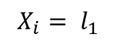
Energies
Unary
Your final label does not agree with the initial classifier
→ you pay a penalty
In our case, the initial classifier is FCN
Pairwise
Detection
Superpixels
$$X_{i}= l_{1}$$
Notes:
The unary energy is the most simple one
This acts on a clique containing just one variable
This is obtained from just taking the negative log of the probability output by a classifier.
In fact, we can think of a standard FCN is being only the unary term
If we only consider the unary term, we are predicting all the pixels independently

Slide 9
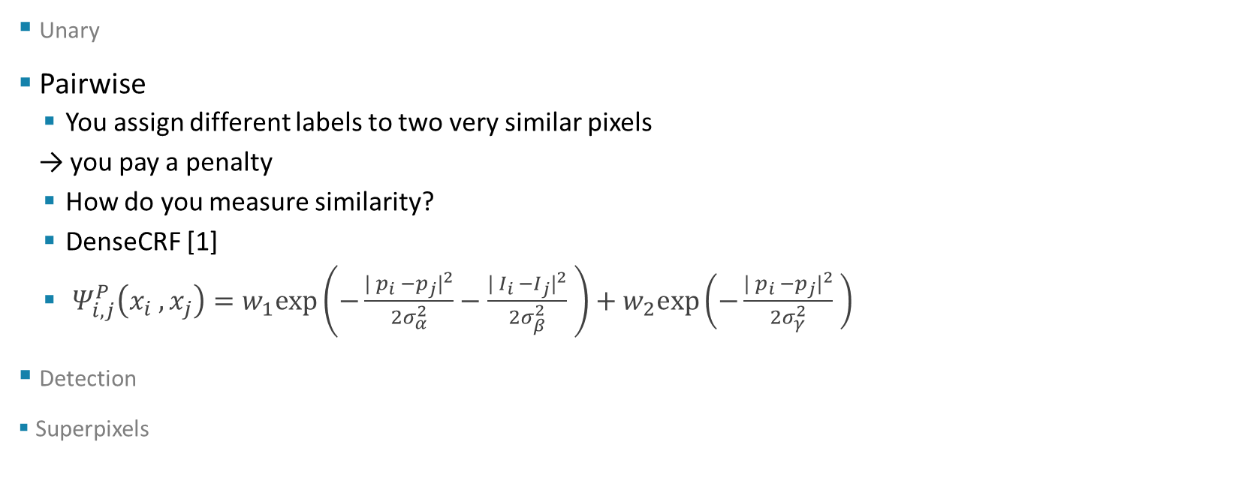
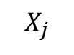
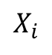
Energies
Unary
Pairwise
You assign different labels to two very similar pixels
→ you pay a penalty
How do you measure similarity?
DenseCRF [1]
$Ψ_{i,j}^{P}\left(x_{i} , x_{j}\right)=w_{1}exp\left(−\frac{| p_{i} −p_{j}|^{2}}{2σ_{α}^{2}}−\frac{| I_{i} −I_{j}|^{2}}{2σ_{β}^{2}} \right)+w_{2}exp\left(−\frac{| p_{i} −p_{j}|^{2}}{2σ_{γ}^{2}} \right)$
Detection
Superpixels
$$X_{i}$$
$$X_{j}$$
[1] Krahenbuhl and Koltun, NIPS, 2011
Notes:
The pairwise term is used to encode our priors of what good segmentations are
The most common pairwise term is from the work of DenseCRF.
Here, every two pairs of pixels are connected
We want to encourage nearby pixels to take the same label, since visually, we know that objects are usually continuous.
So the pairwise term takes the form of a bilateral filter, where we pay a higher cost if two pixels take on a different label, and they are very close to each other or they have similar appearance
So we can see here, the cost for assigning different labels is quite low for these two pixels far away and different in appearance, but high for these pixels which are next to each other

Slide 10
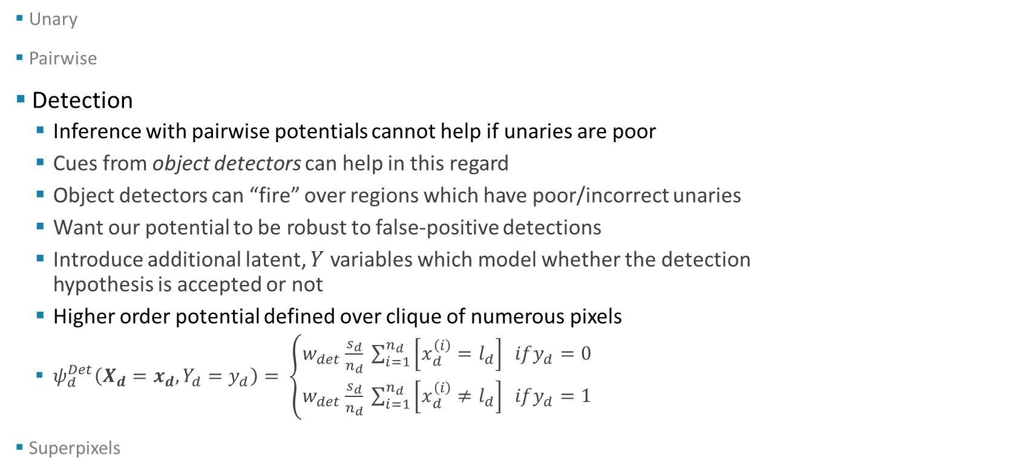
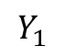
Energies
Unary
Pairwise
Detection
Inference with pairwise potentials cannot help if unaries are poor
Cues from object detectors can help in this regard
Object detectors can “fire” over regions which have poor/incorrect unaries
Want our potential to be robust to false-positive detections
Introduce additional latent, $Y$ variables which model whether the detection hypothesis is accepted or not
Higher order potential defined over clique of numerous pixels
$ψ_{d}^{Det}\left(X_{d}=x_{d}, Y_{d}=y_{d}\right)= \left\{\begin{aligned}w_{det}\frac{s_{d}}{n_{d}} \sum_{i=1}^{n_{d}}{\left[x_{d}^{\left(i\right)}=l_{d}\right] ify_{d}=0} \\ w_{det}\frac{s_{d}}{n_{d}} \sum_{i=1}^{n_{d}}{\left[x_{d}^{\left(i\right)}≠l_{d}\right] ify_{d}=1}\end{aligned}\right.$
Superpixels
$$Y_{1}$$
Notes:
An object detection potential is one of the novel parts of our work.
One of the failure cases of just pairwise potentials is that they do not really help if the unaries are poor.
But cues from object detectors can help in this regard
If we know an object detector has fired over a region in an image, then we know that object class is probably there somewhere.
And we could use this cue from an object detector to help in case our unareis are poor.
However, we also want to be robust to errors in the object detector, since it might have false positive detections.
To achieve this, we also introduce latent Y variables which model whether we accept the object detector hypothesis or not
We introduce a higher order clique that consists of all the pixels over the area which the object detector fired over.
And we have a potential which says that if the Y variable is 1, and the X variables do not take on the label predicted by the object detector, then there is a cost incurred
This encourages the X and Y variables to be consistent with each other
And also means that object detections, ie Y variables, can be ignored if they do not agree with other potentials

Slide 11
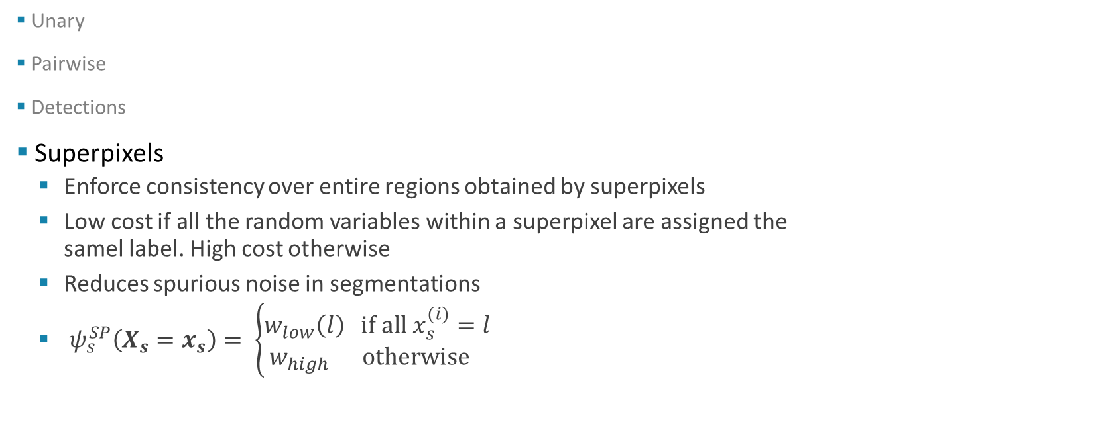
Energies
Unary
Pairwise
Detections
Superpixels
Enforce consistency over entire regions obtained by superpixels
Low cost if all the random variables within a superpixel are assigned the samel label. High cost otherwise
Reduces spurious noise in segmentations
$ψ_{s}^{SP}\left(X_{s}=x_{s}\right)= \left\{\begin{aligned}w_{low}\left(l\right) \text{if} \text{all} x_{s}^{(i)}=l \\ w_{high} \text{otherwise} \end{aligned}\right.$
Each colour represents a different superpixel
Notes:
We also have superpixel based potentials, which are another contribution
We obtain a superpixel oversegmentation of the image, and then enforce consistency over these entire regions
Ie you incur a high cost if different pixels within the superpixel take on different labels
This helps to reduce spurious noise that you get in your output

Slide 12
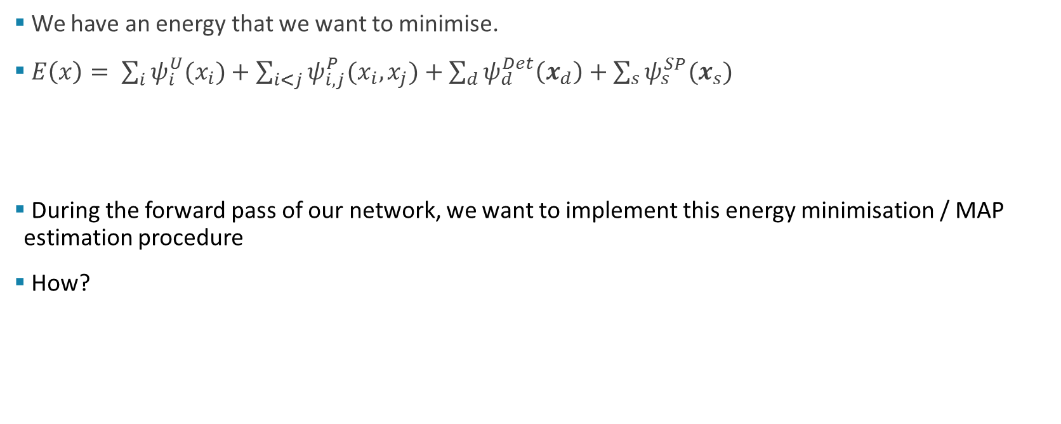
Inference
We have an energy that we want to minimise.
$E\left(x\right)= \sum_{i}{ψ_{i}^{U}(x_{i})}+\sum_{i<j}{ψ_{i,j}^{P}(x_{i}, x_{j})}+\sum_{d}{ψ_{d}^{Det}\left(x_{d}\right)+\sum_{s}{ψ_{s}^{SP}(x_{s}})}$
During the forward pass of our network, we want to implement this energy minimisation / MAP estimation procedure
How?
Unaries from CNN
Pairwise [1]
Detection potentials
Superpixel potentials
[1] Krahenbuhl and Koltun, NIPS, 2011
Notes:
So far, I have talked about energy that we want to minimise
And we want to do this as a layer in our neural network
An option would be to do gradient descent within the neural network itself.
But that is not really feasible, since during backprop, you would have to take gradients of the gradients.
And computing Hessians in neural nets that have millions of parameters is just not computationally feasible

Slide 13
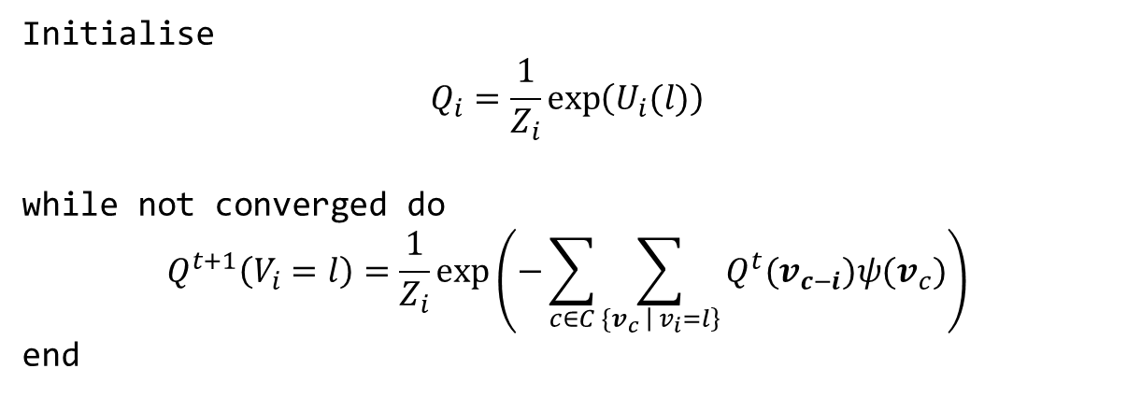
Mean Field
An approximate method. Works well in practice
Initialise
$$Q_{i}=\frac{1}{Z_{i}}\exp\left(U_{i}(l)\right)$$
while not converged do
$$Q^{t+1}\left(V_{i}=l\right)=\frac{1}{Z_{i}}\exp\left(−\sum_{c∈C}{\sum_{{\{v}_{c} \left| v_{i}=l\right\}}{Q^{t}(v_{c−i}}})ψ(v_{c})\right)$$
end
Notes:
Instead, we make use of the fact that although we want to minimise an energy, this is also the MAP estimate of the probability distribution defined by our CRF, which I will call P.
So we can find a distribution Q, that is close to P
And if we make Q something simple, like a fully factorised distribution, then finding its MAP estimate is trivial.
Mean field is an iterative method which can do this task.
It iteratively minimises the KL divergence between P and Q
And if Q is chosen to be a product of independent marginal, then you get this update equation

Slide 14
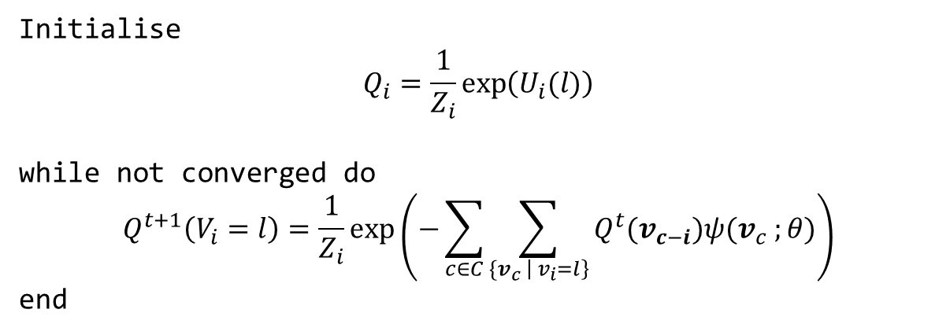
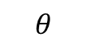
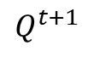
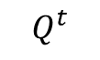
Mean Field
$$Q^{t}$$
MF Iteration
$$Q^{t+1}$$
An approximate method. Works well in practice
$$θ$$
Initialise
$$Q_{i}=\frac{1}{Z_{i}}\exp\left(U_{i}(l)\right)$$
while not converged do
$$Q^{t+1}\left(V_{i}=l\right)=\frac{1}{Z_{i}}\exp\left(−\sum_{c∈C}{\sum_{{\{v}_{c} \left| v_{i}=l\right\}}{Q^{t}(v_{c−i}}})ψ(v_{c} ;θ)\right)$$
end
Linear with respect to Q
Notes:
Note, we could implement the iterative update in the loop as a layer in a neural net
The gradient of the output with respect to the input is quite simple, since it is linear.
And if our potential functions are differentiable, then we can learn their parameters using backpropogation too!
Since this is an iterative process, we implement this as an RNN. And we have a fixed number of iterations. In practice, 5 works well

Slide 15
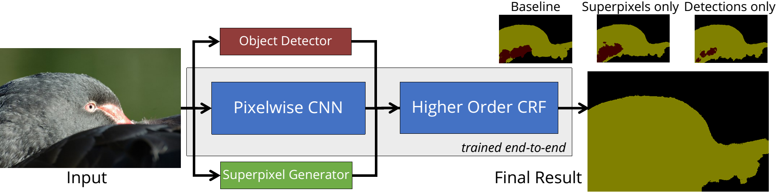
Putting it together
[1] Ren et al. NIPS 2015. [2] Felzenszwalb and Huttenlocher. IJCV 2004
Notes:
So putting everything together, we have a big neural network, where the CRF is a module that we add to an existing neural net.
And object detections and superpixels are additional inputs that we take in

Slide 16
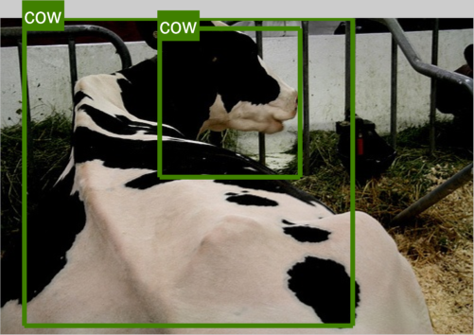


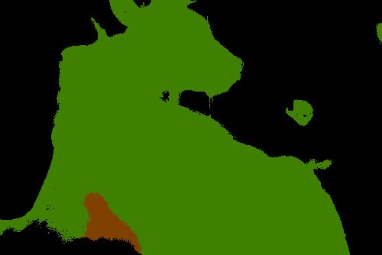
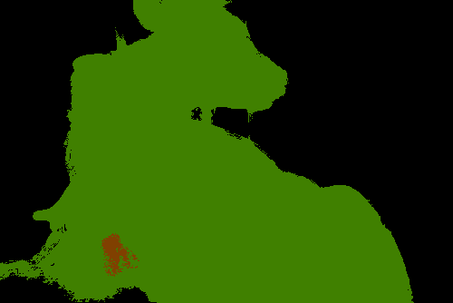


Results
FCN
Pairwise only
Superpixels
Detections
All
Notes:
So you can see, that plain FCN produces quite noisy results
And they are quite bad around image edges due to all of the max pooling that it does in the network
Pairwise potentials give us a sharper output that adheres to image edges.
Superpixel potentials get rid of some of the spurious noise (especially the big patches)
And object detections help in the regions where we don’t have good unaries, like the bottom corner)

Slide 17
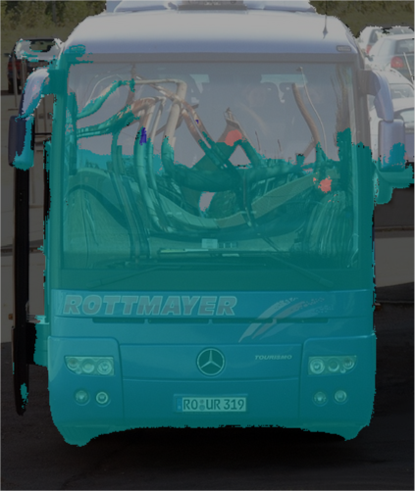
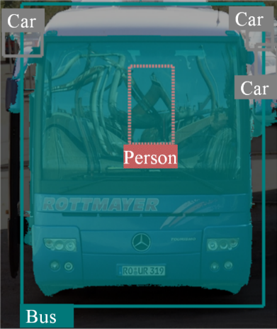
Results
On PASCAL VOC 2012 reduced validation set
Pairwise only
Pairwise and detections
Method | Mean IoU [%]
FCN | 68.3
Pairwise [1] | 72.9
Superpixels | 73.6
Detections | 74.4
Superpixels and Detections | 75.1
[1] Zheng, Jayasumana et al. ICCV 2015
Notes:
And we can see that results, on the validation set, get better when we add these potentials in
The improvement over FCN is quite large

Slide 18

Results
On PASCAL VOC 2012 test set
Notes:
Higher Order CRF was on top for about 3 months. Surpassed by methods using ResNet, our unaries were based on VGG
Last year, CRF-RNN with only pairwise terms was on top

Slide 19
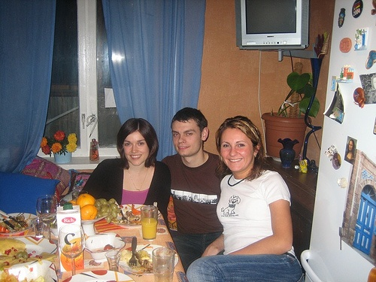

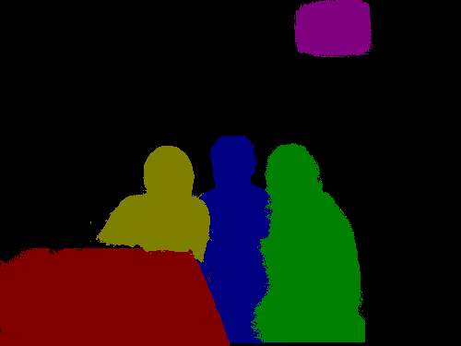
Instance Segmentation
Notes:
Semantic segmentation is now getting really good (we’ve been beaten on the leaderboard).
Recovering instances seems a more interesting problem
Standard semantic segmentation can’t tell you how many people there are

Slide 20
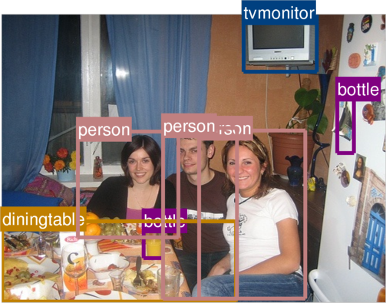
Embarrassingly Simple Instances
Notes:
But on the other hand, we are using object detection information.
Object detectors localise images, but do so on a very coarse scale.
A really simple hack, that works, is just to say:
“Each detection bounding box specifies a potential instance
If a segmentation lies within a bounding box, and they have the same label, then the pixels belong to the instance represented by that particular detection”
This actually works quite well

Slide 21
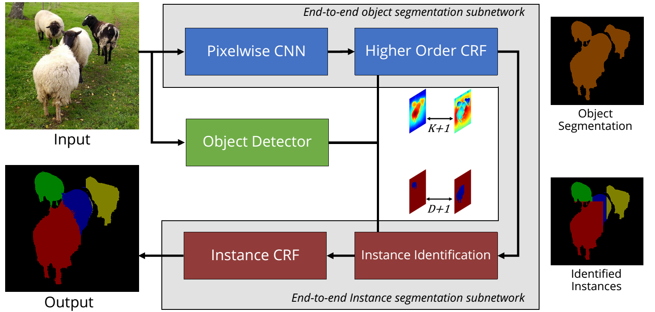
Notes:
So this is just an illustration of the whole thing, which we turn into an end-to-end network
We assume that each object detection represents a possible instance.
Since there are D object detections (where D varies for every image), and some pixels do not belong to any object instance, but are part of the background, we have a labelling problem involving D+ 1 labels in our instance segmentation output.
This D is going to be different for every image
If a pixel falls within the bounding box of a detection, we assign the pixel to that instance with an [unnormalised] probability that is proportional to the rescored detection and semantic segmentation confidence.
If you now just take the argmax of this, then you get a really blocky instance segmentation coming out, as shown in the bottom right.
So now to ameliorate this issue somewhat, we run it through another CRF with only pairwise terms, using the same spatial and appearance consistency priors. And then we can deal with occluding objects of the same class provided that they look a bit different.
==
This was initially implemented as a Python layer in Caffe, since it is quick to code this up
It has then subsequently been made into a C++ layer
CRF layers also needed some modifications
Dynamic number of inputs on each iteration, so this affects the forward and backward passes

Slide 22
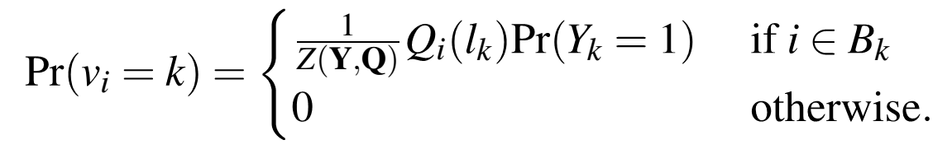
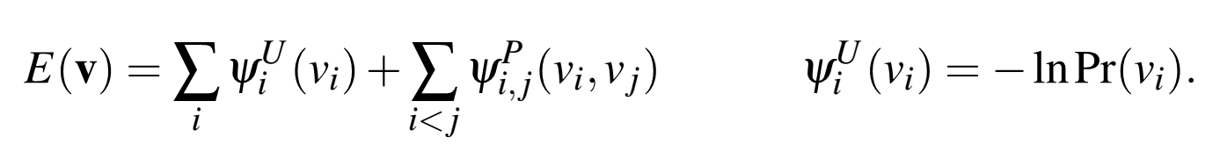
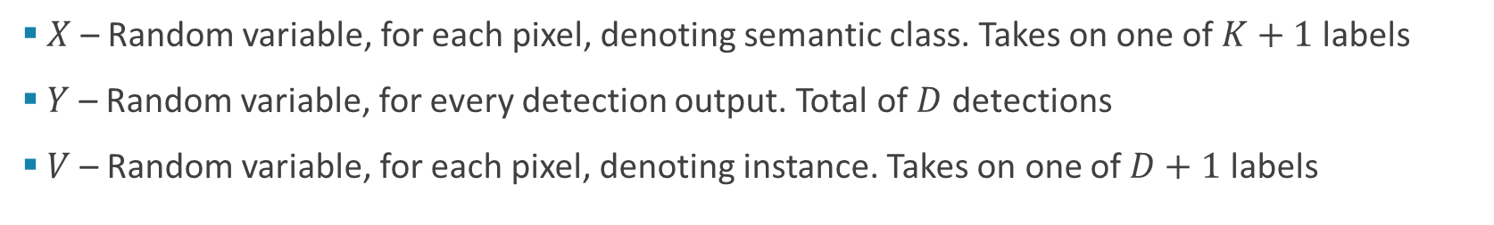
Instance CRF
$X$ – Random variable, for each pixel, denoting semantic class. Takes on one of $K+1$ labels
$Y$ – Random variable, for every detection output. Total of $D$ detections
$V$ – Random variable, for each pixel, denoting instance. Takes on one of $D+1$ labels
Notes:
So this is what it looks like in some maths
The key part is that we assign pixels to the instance corresponding to a detection in a soft manner
This allows everything to be differentiable
X – random variables showing semantic class. K+1 labels, where K is number of foreground classes
Y – random variables denoting object detections. D detections in an image
V – random variables denoting instances.. D + 1 labels. D is the number of detections.

Slide 23
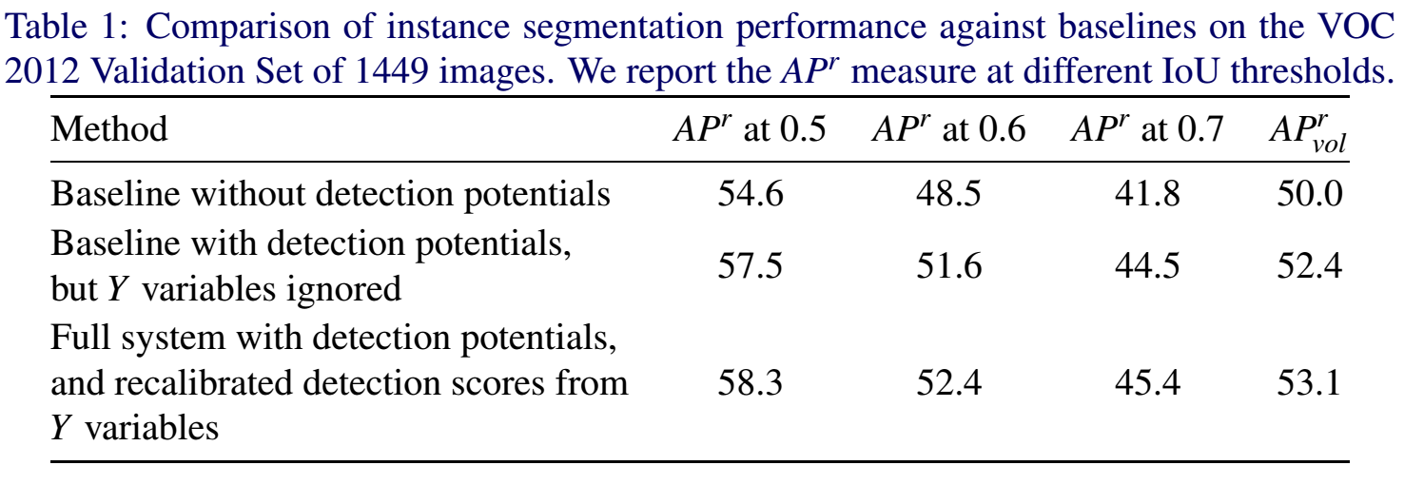
Results
Notes:
Evaluation is the same as object detection.
Using average precision.
More of a ranking metric
Have to find instances. But you have to give them a score as well. And then final AP result is based on the ranking, as well as your correctness
In the case of Instance Segmentation, a segmentation is considered correct if the IoU between the predicted segmentation and ground truth is above a certain threshold. Here we vary it from 0.5 to 0.9 in increments of 0.1.
Have two baselines.
One without any higher order potentials at all. Use original detection scores.
Second baseline, we use higher order potentials to improve our segmentations, but not rescore the detections.
Final version, we rescore our detections as well.
So in short, the improvement from the top to the bottom row is because of the higher order detection potential

Slide 24
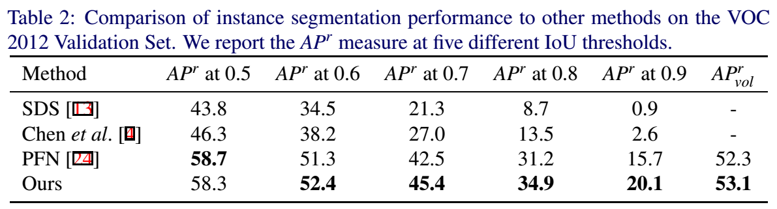
Results
Notes:
We do better then other methods
This table was made for the BMVC deadline
At CVPR, there was a paper that did better than this, but not at a threshold of 0.9
In fact, their advantage over our method decreased the higher the threshold
So because we start off with good semantic segmentations, our results are often more detailed and accurate.
This is what you need to for high thresholds
And this is where we do the best.

Slide 25
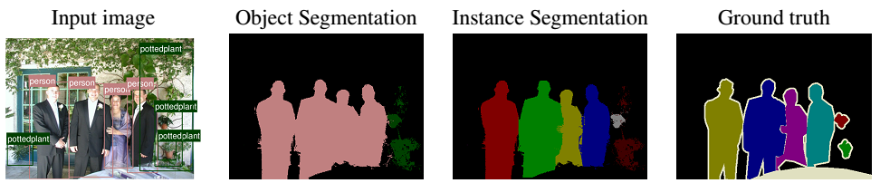
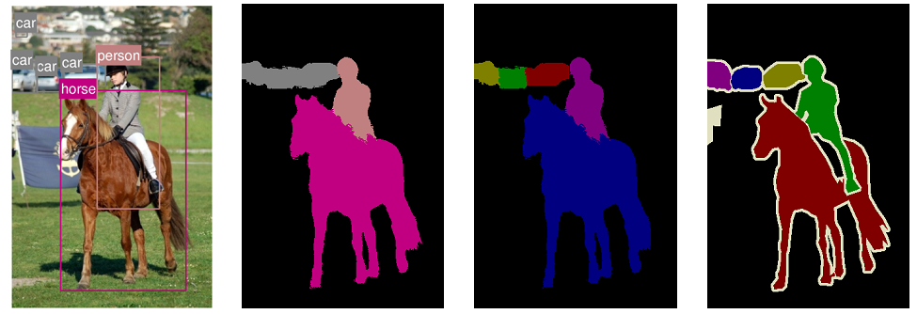
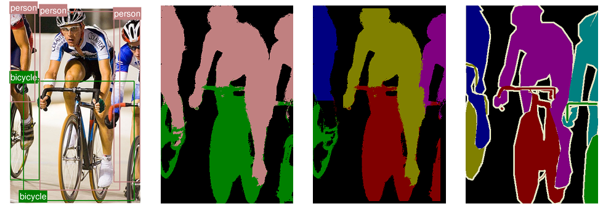
Success Cases
Notes:
Bicycle image
So we couldnDetection didn’t cover the persons leg
’t get it as an instance
A limitation of our method

Slide 26
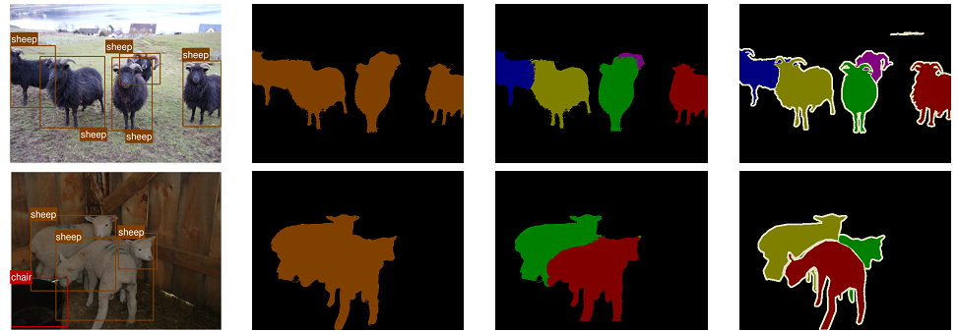
Failure Cases
Notes:
Sheep look very similar to each other
So it becomes very difficult to distinguish instances based on how they look (which is essentially what the pairwise terms of the CRF are doing).

Slide 27


Failure Cases (not just sheep)
Notes:
So in case you thought there’s something unique about sheep

Slide 28

Easy Cases (no occlusions)
Notes:
So in case you thought there’s something unique about sheep

Slide 29
Conclusions
Fully convolutional networks produce a coarse segmentation of an image
CRFs improve the result as they allow us to encode our prior knowledge of a good segmentation
Learning the entire pipeline end-to-end improves results
We can do instance segmentation too

Slide 30
Questions?
Anurag Arnab, Sadeep Jayasumana, Shuai Zheng, Philip H.S. Torr. Higher Order Potentials in End-to-End Trainable Conditional Random Fields. ECCV, 2016
Anurag Arnab, Philip H.S. Torr. Bottom-up Instance Segmentation using Deep Higher-Order CRFs. BMVC, 2016.
Shuai Zheng, Sadeep Jayasumana, Bernardino Romera-Paredes, Philip H.S. Torr. Conditional Random Fields as Recurrent Neural Networks. ICCV, 2015

